Slide 1
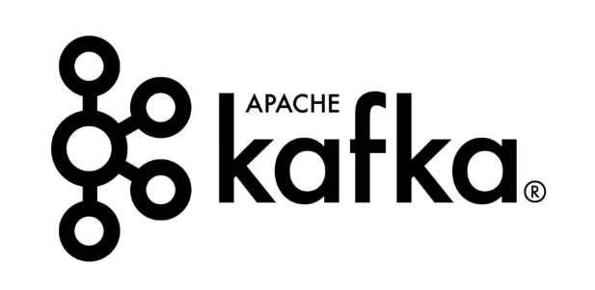
Kafka distributed, scalable, and fault-tolerant messaging system.

Slide 2
Kafka was developed around 2010 at LinkedIn by a team that included Jay Kreps, Jun Rao, and Neha Narkhede.
The problem they originally set out to solve was low-latency ingestion of large amounts of event data from the LinkedIn website and infrastructure into a lambda architecture that harnessed Hadoop and real-time event processing systems. The key was the "real-time" processing.

Slide 3
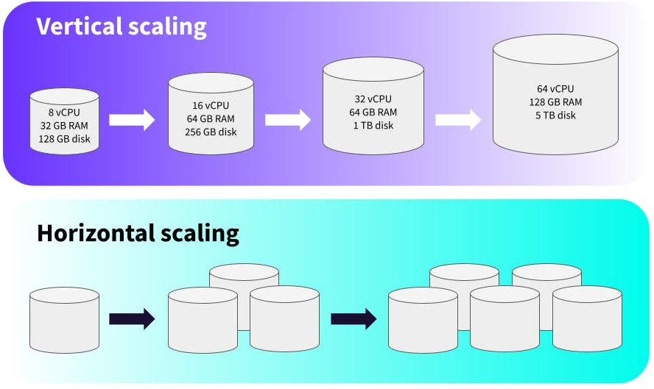
Prior to Apache Kafka, the JMS (Java Messaging Service) based solutions like IBM MQ, WebSphere MQ, Active MQ and other messaging services were available. These services were not fault tolerant in nature and they could not be scaled horizontally beyond a limit.

Slide 4
How does Kafka work?
Kafka looks and feels like a publish-subscribe system that can deliver in-order, persistent, scalable messaging. It has publishers, topics, and subscribers. It can also partition topics and enable massively parallel consumption.
All messages written to Kafka are persisted and replicated to peer brokers for fault tolerance, and those messages stay around for a configurable period of time (i.e., 7 days, 30 days, etc.).

Slide 5
Log data structure
Kafka uses Log data structure
The log is simply a time-ordered, append-only sequence of data inserts where the data can be anything (in Kafka, it's just an array of bytes). If this sounds like the basic data structure upon which a database is built, it is.

Slide 6
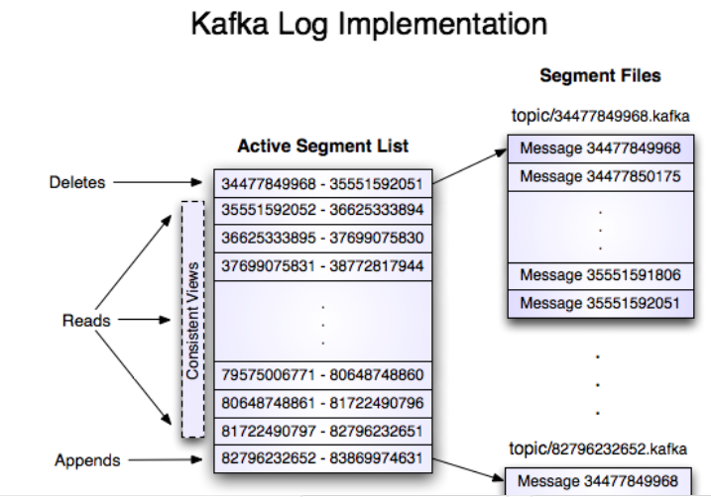
Log data structure

Slide 7
Case study
Back in 2011, Kafka was ingesting more than 1 billion events a day. Recently, LinkedIn has reported ingestion rates of 1 trillion messages a day
Kafka is used heavily in the big data space as a reliable way to ingest and move large amounts of data very quickly. For example, Netflix started out writing its own ingestion framework that dumped data into Amazon S3 and used Hadoop to run batch analytics of video streams, UI activities, performance events, and diagnostic events to help drive feedback about user experience. As the demand for real-time (sub-minute) analytics grew, Netflix moved to using Kafka as its primary backbone for ingestion via Java APIs or REST APIs. Netflix's system now supports ingestion of ~500 billion events per day (~1.3 PB data) and at peak up to ~8 million events per second.

Slide 8
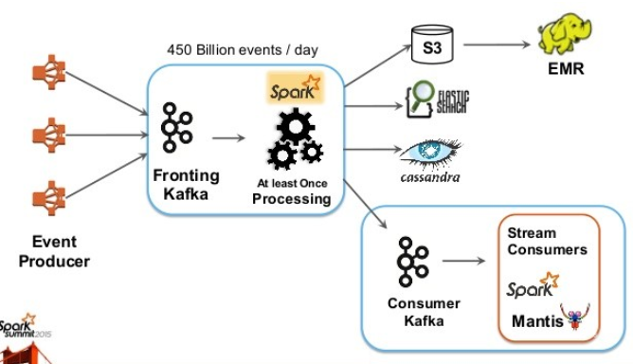
Netflix example

Slide 9
Log data structure
In Kafka, messages are written to a topic, which maintains this log (or multiple logs — one for each partition) from which subscribers can read and derive their own representations of the data (think materialized view).
For example, a "log" of the activity for a shopping cart could include "add item foo," "add item bar," "remove item foo," and "checkout." The log would present these facts to downstream systems. If a shopping cart service reads that log, it can derive the shopping cart objects that represent what's in the shopping cart: item "bar" and ready for checkout. Because Kafka can retain messages for a long time (or forever), applications can rewind to old positions in the log and reprocess. Think of the situation where you want to come up with a new application or new analytic algorithm (or change an existing one) and test it out against past events.

Slide 10
Kafka in Microservices
As powerful and popular as Kafka is for big data ingestion, the "log" data structure has interesting implications for applications built around the Internet of Things, microservices, and cloud-native architectures in general.
Domain-driven design concepts like CQRS and event sourcing are powerful mechanisms for implementing scalable microservices, and Kafka can provide the backing store for these concepts. Event sourcing applications that generate a lot of events can be difficult to implement with traditional databases, and an additional feature in Kafka called "log compaction" can preserve events for the lifetime of the app.
Basically, with log compaction, instead of discarding the log at preconfigured time intervals (7 days, 30 days, etc.), Kafka can keep the entire set of recent events around for all the keys in the set. This helps make the application very loosely coupled, because it can lose or discard logs and just restore the domain state from a log of preserved events.

Slide 11
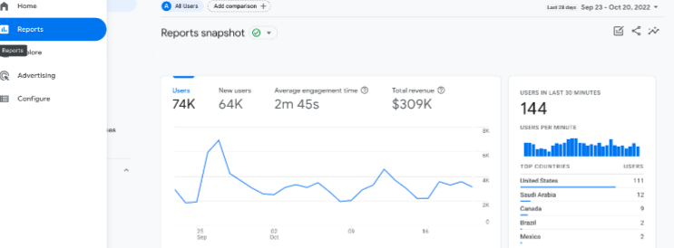
Kafka and traditional messaging competitors
Just as the evolution of the database from RDBMS to specialized stores has led to efficient technology for the problems that need it, messaging systems have evolved from the "one size fits all" message queues to more nuanced implementations (or assumptions) for certain classes of problems. Both Kafka and traditional messaging have their place.
Real-time data processing refers to the capturing and storing of event data in real-time. Conventional data pipelines run in scheduled batches and process all aggregated information during a specified time but Apache Kafka allows organizations to process data on the fly. Kafka captures, transforms, stores, and loads data into relevant applications in real-time.
A prime example of real-time data capture and processing is the Google Analytics engine.

Slide 12
Kafka and zookeeper
ZooKeeper plays a crucial role in coordinating and managing the distributed environment. ZooKeeper is primarily used to track the status of nodes in the Kafka cluster and maintain a list of Kafka topics and messages.
It serves as a centralized spot for maintaining and storing the metadata for Kafka, which includes details on topics, partitions, consumer offsets, and cluster setup. ZooKeeper maintains a consistent picture of the cluster across all participating Kafka brokers, ensuring data consistency and fault tolerance. In a Kafka cluster, ZooKeeper ensures fault tolerance by keeping consistent metadata across brokers.
For example kafka is like a big library where lots of books are stored, lot of people visits for reading purpose and zookeeper is like Library Manager.

Slide 13
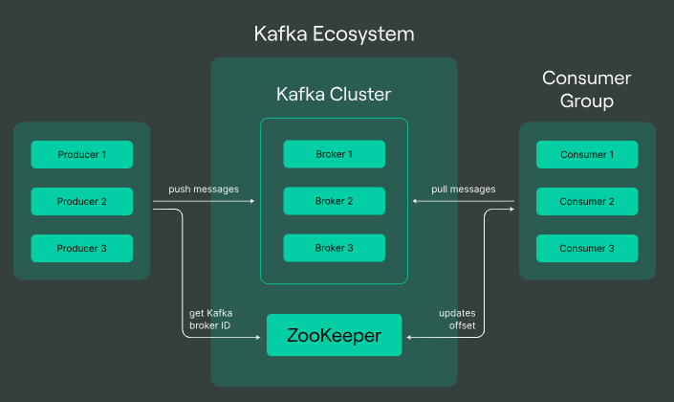
kafka and Zookeeper

Slide 14
Why Should You Use Apache Kafka?
Scalability.
High throughput.
Real-time data processing
Operational metrics/KPIs

Slide 15
Kafka vs. Traditional Messaging Systems
Kafka vs. Traditional Messaging Systems
Kafka differs from traditional messaging queues in several ways. Kafka retains a message after it has been consumed. Quite the opposite, competitor RabbitMQ deletes messages immediately after they've been consumed.
RabbitMQ pushes messages to consumers and Kafka fetches messages using pulling.
Kafka can be scaled horizontally and traditional messaging queues can scale vertically.

Slide 16
Case studies
LinkedIn: The LinkedIn tech stack uses Kafka for message exchange, activity tracking, and logging metrics. With over 100 Kafka clusters, they can process 7 trillion messages daily.
Uber: With one of the largest deployments of Apache Kafka in the world, uber uses the streaming platform for exchanging data between a user and driver.
Netflix: Netflix tracks activity for over 230 Million subscribers using the Kafka platform. It stores details like watch history, movie likes and dislikes, and what you watch to power its recommendation system.

Slide 17
Use cases
Real-time processing has opened up several new opportunities in different industries. Business leaders leverage Kafka for revenue generation, customer satisfaction, and business growth.
Let’s discuss a few niches that are using Apache Kafka well.
Financial services
The financial sector generates data in the count of millions daily. The sheer amount of financial transactions and the volume of customers is too much for conventional systems to handle. Apache Kafka handles all business-critical and high-volume workloads, ensuring customers get a seamless experience. Moreover, banks and other financial services use it for generating real-time analytics and powering machine learning models for applications like fraud detection.
Paypal — Handling about 1 trillion messages per day.

Slide 18
Use cases
AdTech
Forming aggregated analytics can be cumbersome when running marketing campaigns across multiple platforms. Kafka can build connections to multiple platforms like Google, Facebook, Twitter, or LinkedIn. It can gather marketing data as the user interactions are active and use this real-time information to form analytics. The low latency system can help business leaders and marketing experts plan their future campaigns without delay.
Internet of Things (IoT)
Kafka supports back-and-forth communication between the devices by building a persistent channel.
Gaming players play against each other in real-time.

Slide 19
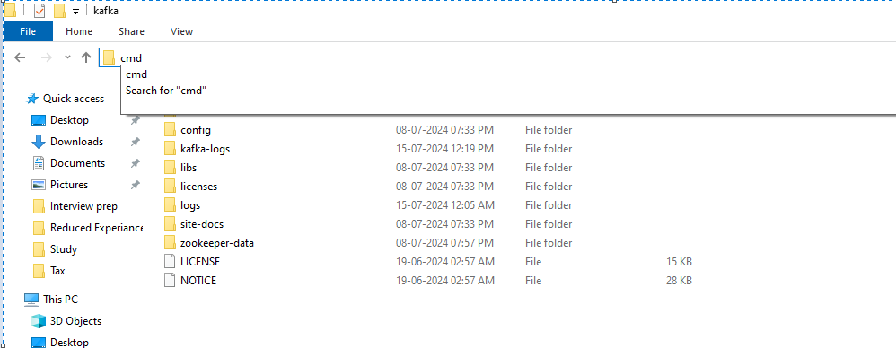
How to Run Kafka and Zookeeper
Inside kafka folder, open cmd.

Slide 20
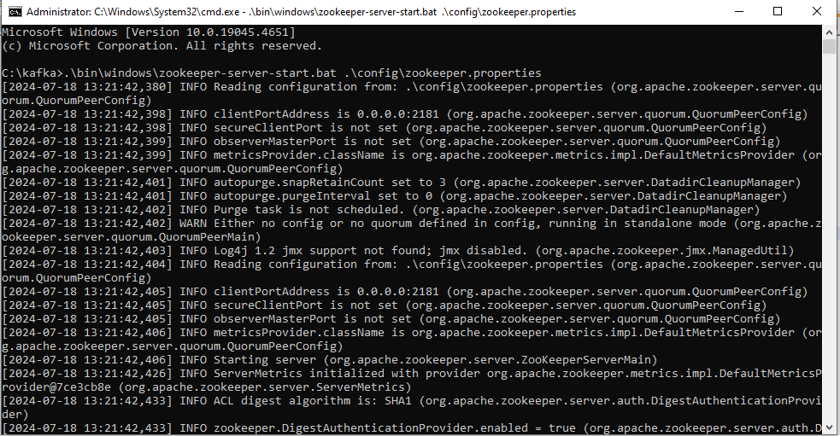
How to Run Kafka and Zookeeper
First run zookeeper

Slide 21
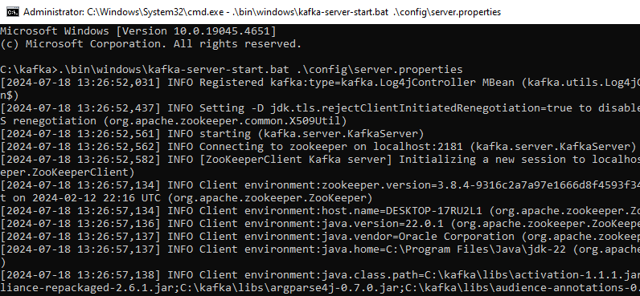
How to Run Kafka and Zookeeper
Run kafka

Slide 22
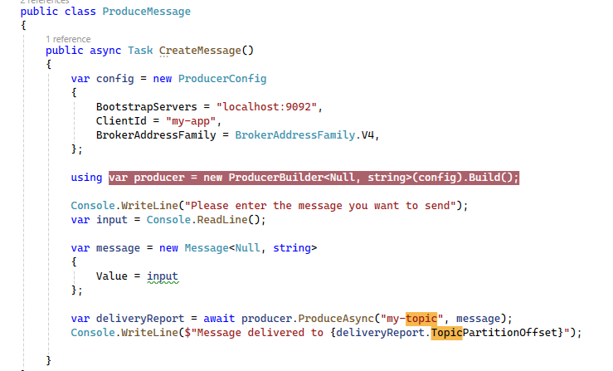
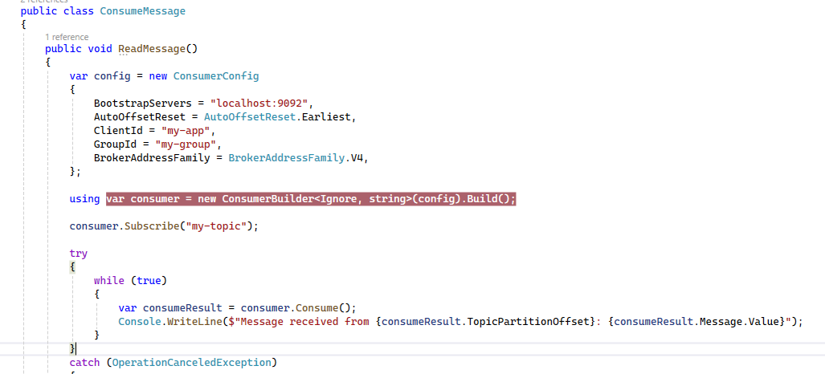
.net core producer and consumer

Slide 23
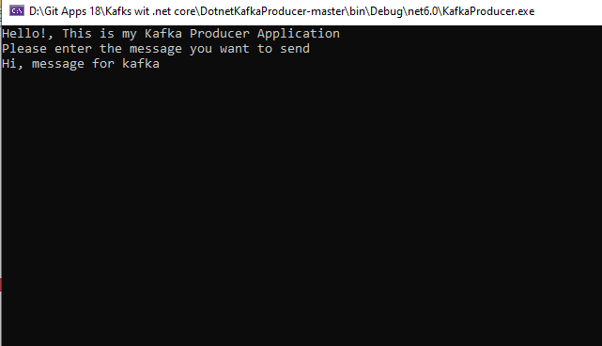
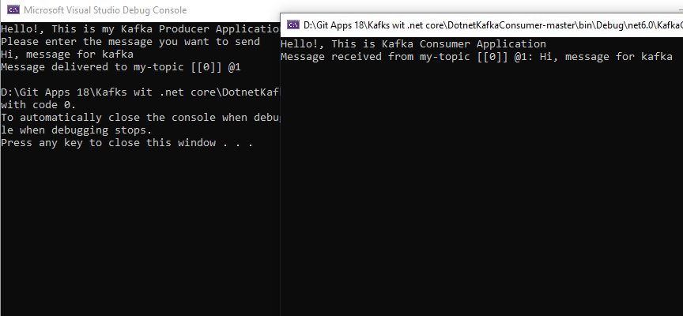
.net core producer and consumer

Slide 24
Typical Use Cases
Log aggregation: You can publish logs to Kafka topics and then aggregate and process them when needed. Kafka can collect logs from various services and make them available to the consumers in a standard format (JSON).
Real-time data processing: Today's applications need data to be processed as soon as it's available. IoT applications also need real-time data processing.
Operational metrics: Kafka can aggregate the statistical data collected from several distributed applications and then produce centralized feeds of operational data.

